Slide 1

XGBOOST Python
Library
Prepared by group 1
Enhancing Machine Learning Strategy
14 July, 2025

Slide 2
Introduction
What is XGboost ?
--> Xgboost is a powerful machine learning algorithm.
--> It is designed to optimize performance and computational speed
open source .
--> Primary C++ implementation Created by Tianqi chen.
--> Widely accepted algorithms in Kaggle competion.

Slide 3
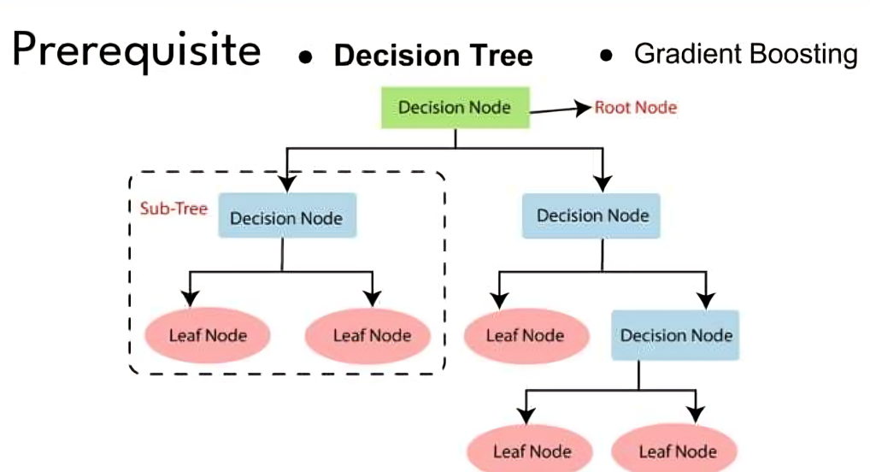
Prerequisite

Slide 4
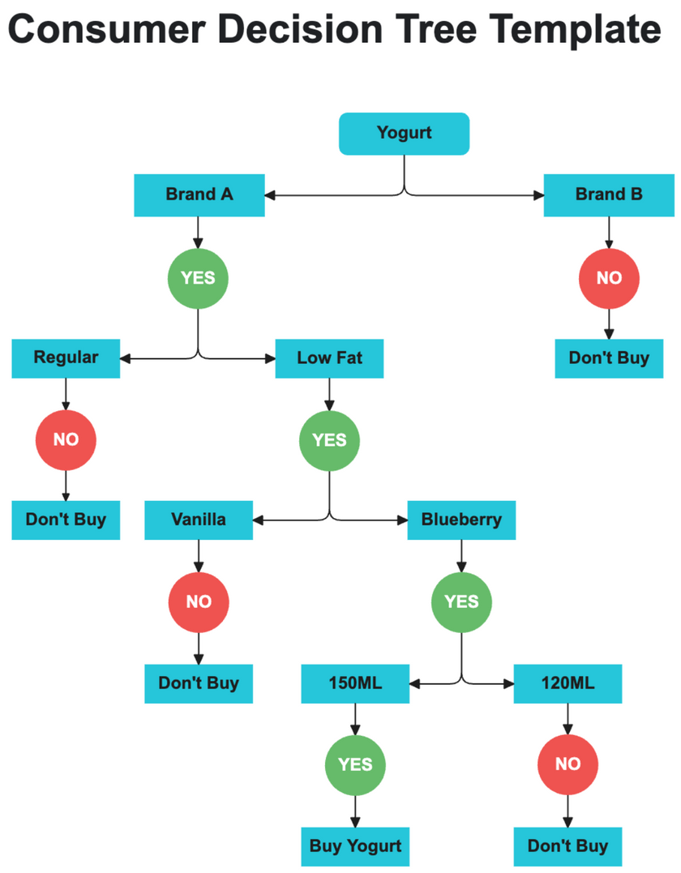
Prerequisite :Decision Tree :Gradient boosting
1. Node and Branches:-
A decision tree consists of nodes and branches.
Nodes represent decisions or questions based on features.
Branches represent possible outcomes or decisions based on those question.
2. Root node:-
the top-most node is called root node.
3. Internal Nodes:-
Nodes other than the root node are internal nodes.
They Represent intermediate decisions/questions.
4. Leaf Node:-
Terminal nodes are called leaf nodes.
They represent the final outcomes or predictions.

Slide 5

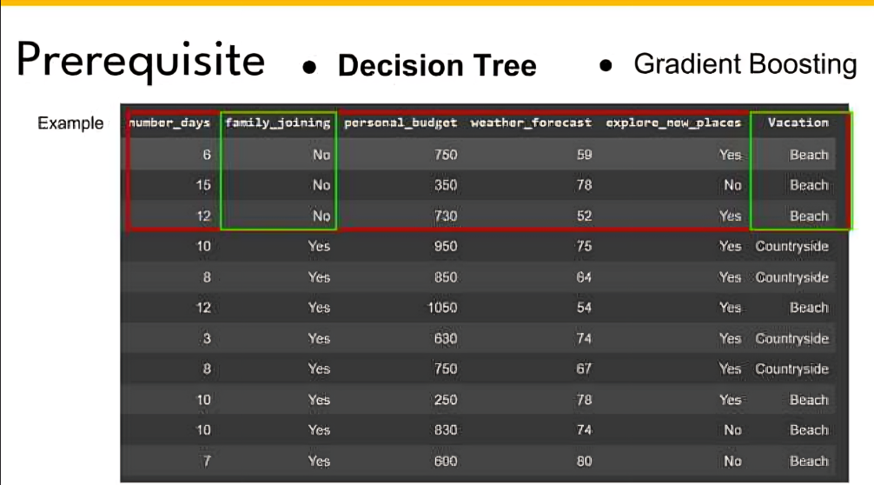
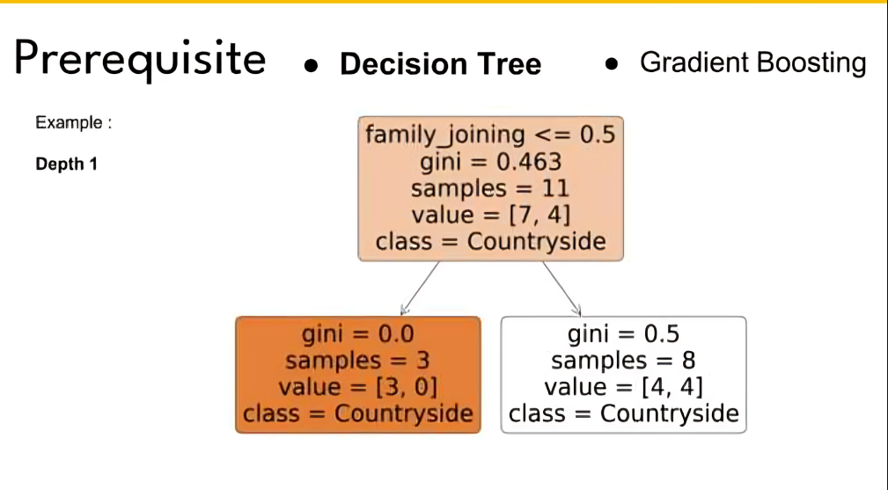
Prerequisite :Decision Tree :Gradient boosting

Slide 6
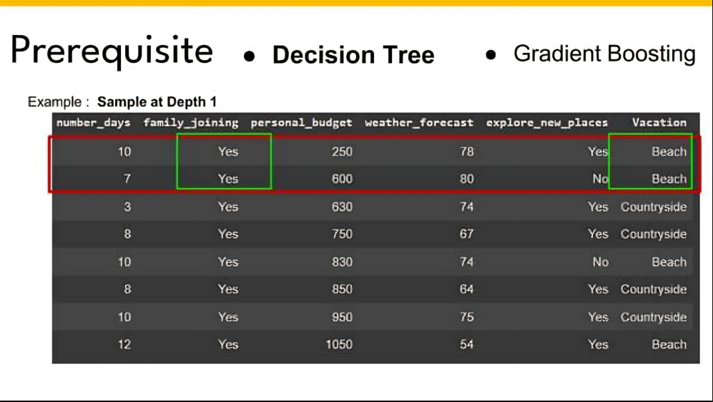
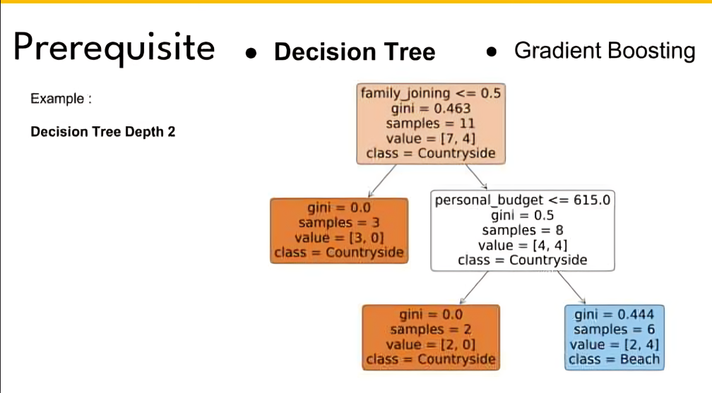
Prerequisite :Decision Tree :Gradient boosting

Slide 7



Prerequisite :Decision Tree :Gradient boosting
Gradient Boosting is one of the most powerful techniques for building predictive models, and it is called a Generalization of AdaBoost . The main objective of gradient Boost is to minimize the loss function by adding weak learners using a gradient descent optimization algorithm.
Gradient Boost has three main components :-
Additive Model
It is an iterative and sequential process in adding the decision trees one step at a time.
A gradient descent procedure is used to minimize the loss when adding tress.
Here instead of changing the weak learner we add a new parametrized DT to predict residual.
Loss Function
Weak Learner
The role of the loss function is to estimate how best is the model in making predictions with the given data.
This could vary depending on the type of the problem
Weak learner is one that classifies the data so poorly when compared to random guessing .
Weak learner are mostly decision tress

Slide 8
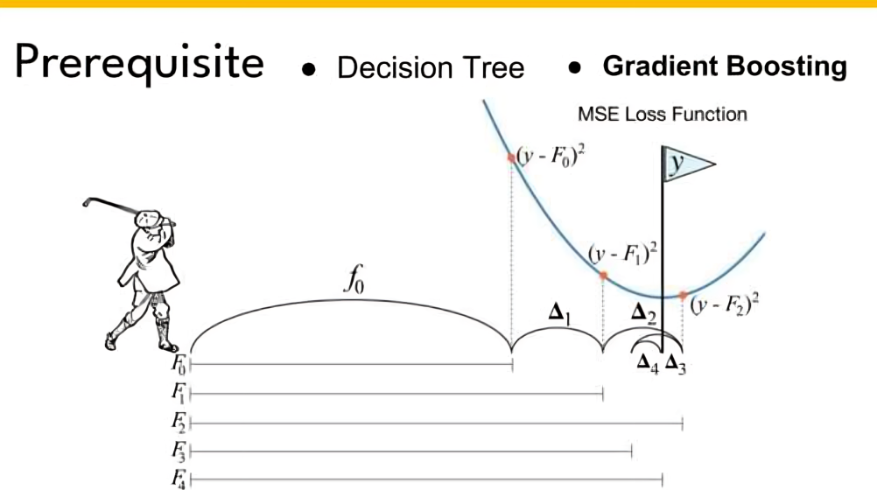
Prerequisite :Decision Tree :Gradient boosting

Slide 9
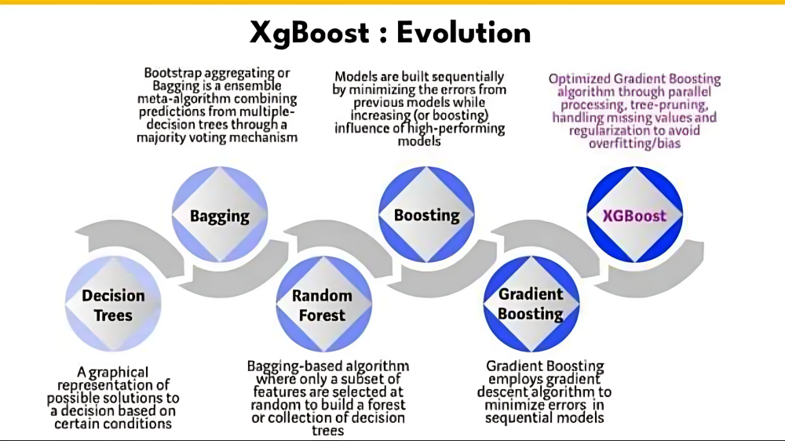
XGBoost : Evolution

Slide 10
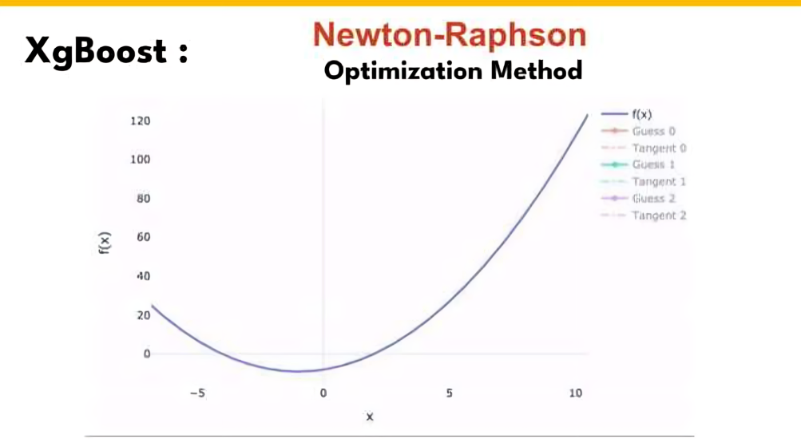
XGBoost :

Slide 11
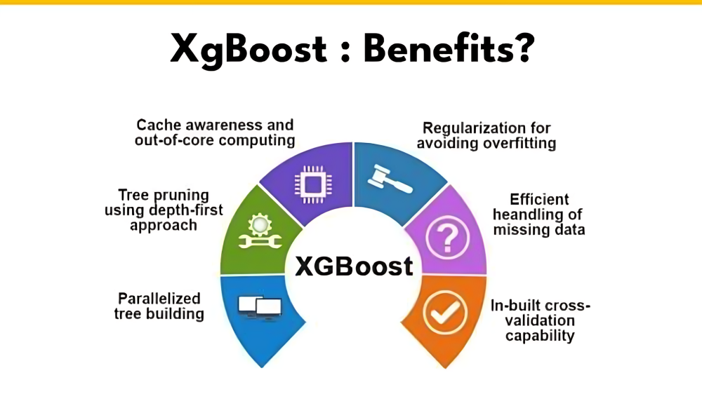

Slide 12

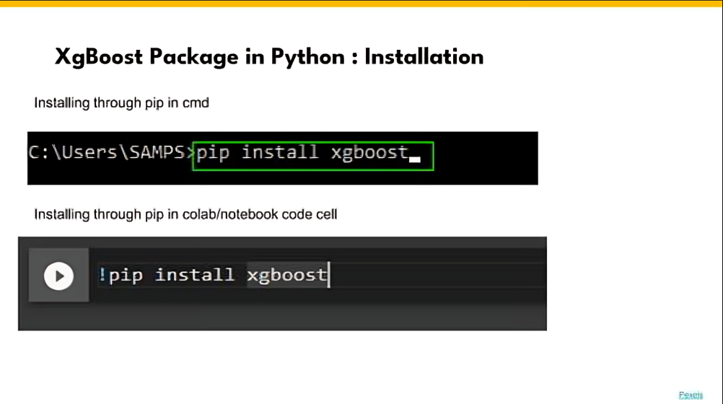
XGboost Package in Python : Installation

Slide 13
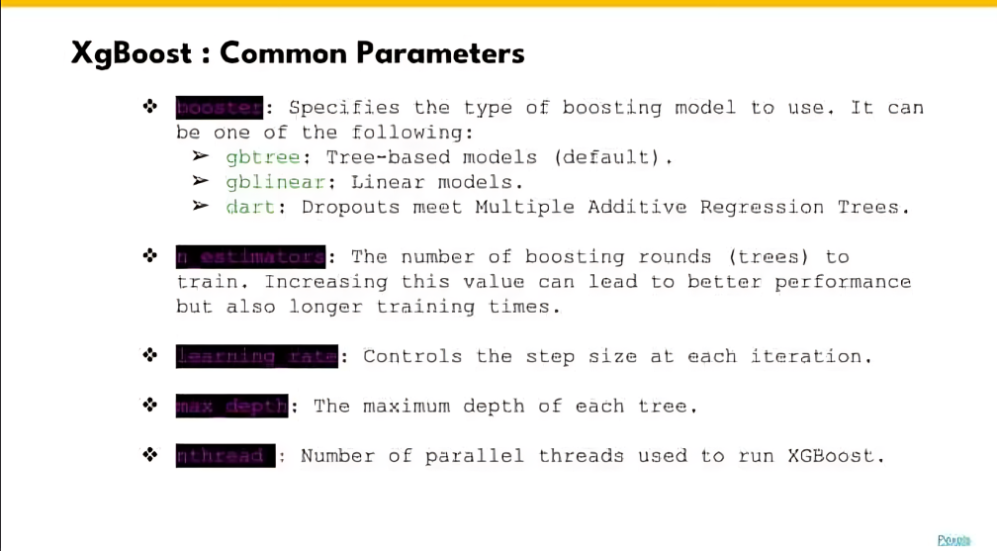

Slide 14
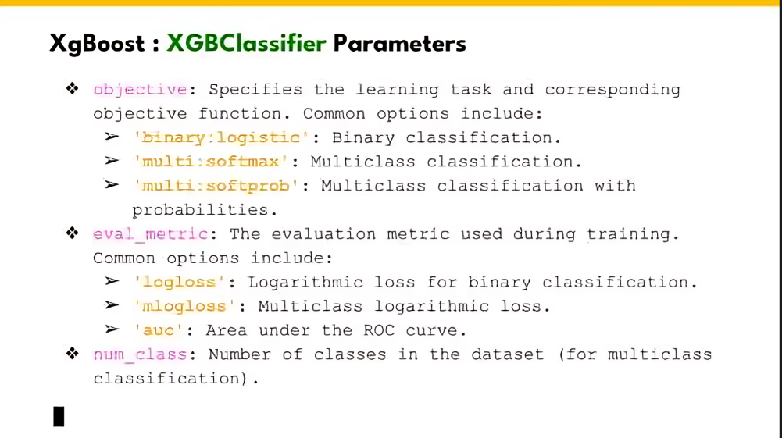

Slide 15
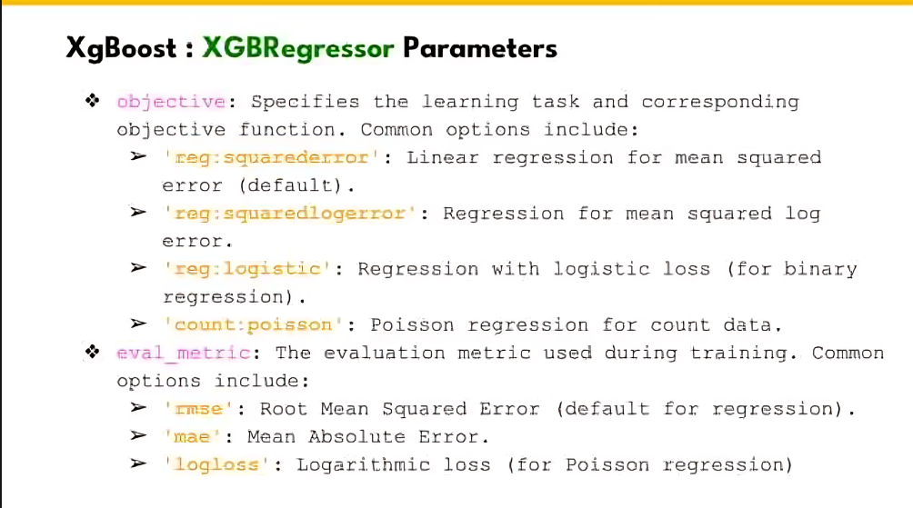

Slide 16
Refrences
https://xgboost.readthedocs.io/en/stabl/
https://www.geeksforgeeks.org/machine-learning/xgboost/
https://www.sciencedirect.com/topics/computer-science/extreme-gradient-boosting

Slide 17
Thank you

